Slide 1
Becoming Trauma Informed
By Marianne Boykin, MS, LPC
and
Laurie Eldred, LMSW

Slide 2
Agenda
1. Discussion of trauma and toxic stress; definition and types.
2. Impact of Trauma and Toxic stress on the person including brain development.
3. What is my therapist doing???
4. How to respond as a foster care parent.
BREAK!!!
5. How does the trauma impact me?
6. Resiliency Factors.
7. Conclusion.

Slide 3
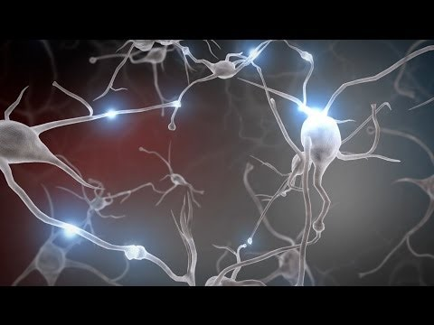
What is Trauma and Toxic Stress???

Slide 4
What is Trauma???
According to DSM IV- TR, PTSD involves a person having experienced, witnessed or have been confronted with an event or events that involved actual or threatened death or serious injury or a threat to the physical integrity of self or others. It also states that the person’s response involved intense fear, helplessness or horror.
Trauma is different for everyone
Trauma may be more than an event for a child.
Notes:
Visualization exercise involving snake in a park to illustrate traumatic events differ according to individual

Slide 5
Two types of Trauma
Two types of trauma
Acute Traumatic Events: School shootings; Gang-related violence in the community; Terrorist attacks; Natural disasters (for example, earthquakes, floods, or hurricanes);Serious accidents (for example, car or motorcycle crashes);Sudden or violent loss of a loved one; Physical or sexual assault (for example, being beaten, shot, or raped)
Chronic Traumatic Events: Some forms of physical abuse; Long-standing sexual abuse; Domestic violence; Wars and other forms of political violence

Slide 6
Toxic Stress
Three Types of Stress
Positive
Tolerable
Toxic
Types of Toxic Stress a child may have endured

Slide 7
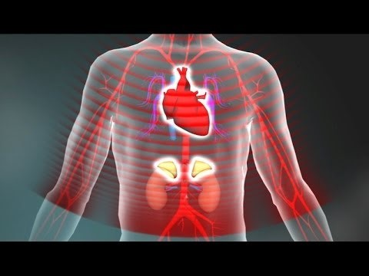
Toxic Stress and Development

Slide 8
Impact of Trauma and Toxic stress on the person including brain development.
Triune Brain Exercise
Physical retention in the body
1. muscle tension 6. Depressed Mood
2. Hyperarousal 7. Fatigue
3. Headaches 8. Digestive issues (colitis, IBS)
4. Anxiety 9. Colds/Other illnesses
5. Changes in sleep/eating

Slide 9
Brain Basics
Thalamus

Slide 10
Amygdala

Slide 11
Hippocampus

Slide 12
Signs of Childhood Traumatic Stress

Slide 13
What this might look like in young children

Slide 14
What is the Therapist doing?
Why talk therapy might not work?!?
Experiential therapies to help build the gaps in the brain.
1. Grounding and Five Senses Handout
2. Mindfulness/Meditation Video
3. Yoga

Slide 15
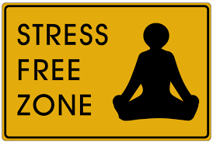
BREAK!!!

Slide 16
How to respond?
Consistency and Structure
Labeling Emotions
Holding Space (Providing opportunity to express the emotions)

Slide 17
How does this impact me?
Secondary Trauma
-Not a sign of weakness!!!
Mirror Neurons
-You are not crazy if you have an emotional response.

Slide 18
How does this impact me?
Important of self-care
Examples of self-care
1. Support Groups
2. Respite
3. Foster care Network

Slide 19
What is resilience?
The ability to Bounce back

Slide 20
Resiliency Factors
Top Protective Factor-You!
Five Protective Factors
Nurture and attachment
Concrete supports
Knowledge of parenting and development
Parental resilience
Having social connects
What is my role as a foster care parent?

Slide 21
Conclusion
Top 3 Things to Remember
1. Trauma is not an event but an experience.
2. Traumatic responses are not choices;
3. Support and Self-care are vital to your survival!!
Questions??? Comments??? Clarifications???

Slide 22
Resources
National Child Traumatic Stress Network
Harvard Center for the Developing Child

