Slide 1
SELF CARE AS A LEADERSHIP SKILL
Laurie Eldred, LMSW-C, CAADC

Slide 2
Who am I as a social worker and leader?
Notes:
-My own story and leadership pathway.
-How many people can relate to this one?

Slide 3
WHAT IS LEADERSHIP FROM A SOCIAL WORKER?

Slide 4
WHAT IS SELF CARE REALLY?
*Hint: It’s not activities*

Slide 5
SELF CARE + LEADERSHIP

Slide 6
SELF CARE IN LEADERSHIP
WHO WE ARE AS SOCIAL WORKERS:

Slide 7
SELF CARE IN LEADERSHIP
WHAT ARE WE SHOWN:

Slide 8
THE SKILL OF SELF CARE AS LEADERSHIP:
3 MAIN POINTS

Slide 9
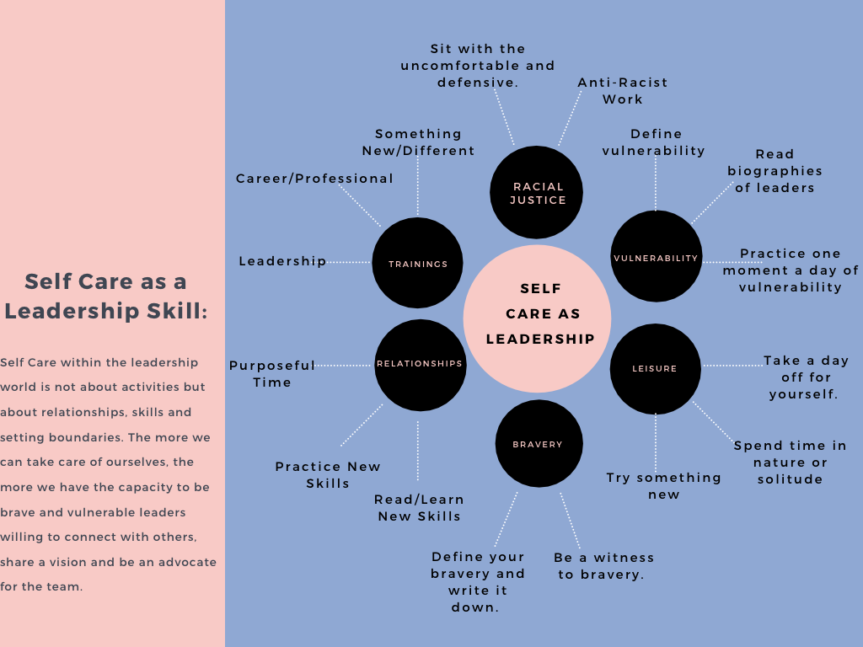
Notes:
HOW CAN THIS LOOK SPECIFICALLY?
ADDRESSING THE PHYSICAL/MENTAL/SPIRITUAL/RELATIONAL/PSYCHOLOGICAL NEEDS.

Slide 10
WHY DOES THIS MATTER?

Slide 11
THIS MATTERS BECAUSE:
PEOPLE
RESOURCES
TRAUMA

Slide 12
RESOURCES:
Brown Brene (2018). Dare to Lead: Brave Work. Tough Conversations. Whole Hearts. New York: Random House.
Brown M.E. (2020). Hazards of Our Helping Profession: A Practical Self-Care Model for Community Practice. Social Work, 65, 38-44.
Lee J.L, Miller S.E., Bride, B.E. (2020). Development and Initial Validation of Self-Care Practices Scale. Social Work, 21-28.
Levine P. A.,(97). Waking the Tiger: Healing Trauma. Berkeley: North Atlantic Books
Miller, J. & Grise-Owen, E. (2020). Self-Care: An Imperative. Social Work, 65, 5-9.
Van Der Kolk, B, MD., (14). The Body Keeps the Score: Brain, Mind, and Body in the Healing of Trauma. New York: Penguin.
Van Dernoot-Lipsky, L., Burk.C (09). Trauma Stewardship: An Everyday Guide to Caring for Self While Caring for Others. Oakland: Berrett-Koehler.

Slide 13
THANK YOU FOR THIS OPPORTUNITY AND I HOPE YOU BRING THE SKILL OF SELF CARE TO YOUR LEADERSHIP TOOL BAG.

