Slide 1
Trauma Doesn’t Only Impact Our Clients: Building A Healthy Self Care Habit.
Laurie Eldred, LMSW, CAADC

Slide 2
Learning Objectives:
1. Recognize at Least 3 indicators of Secondary Trauma.
2. Understand how working effectively with clients means we address our own Trauma.
3. Learn 3 self-care habits to incorporate in our everyday lives.

Slide 3
What did you Learn About Trauma?
Notes:
Informal Poll and flashback to Research 1 and Research 2 (for those from GVSU)
Did you talk about trauma in your classes or have a professor bring this up in class?
What about a supervisor/mentor or other colleague?
We cannot talk about issues of trauma without having a working definition of trauma.

Slide 4
What is Trauma?
DSM-5 has PTSD is one of the only “official” trauma diagnosis:
Exposed to death,threatened death,actual/threatened serious injury, actual/threatened sexual violence.
Either as a witness or direct exposure.

Slide 5
3. Indirectly by learning of a close relative/friend.
4. Repeated or extreme indirect exposure of adverse events (in the course of professional Duties).
5. Intrusive symptoms
6.Persistent avoidance of the associated trauma.
7. Negative changes in thoughts and mood associated with trauma.
8. Changes in behavior that are associated with the trauma event.
Notes:
-Intrusive symptoms: recurrent, involuntary or intrusive memories, nightmares, dissociative reactions (flashbacks that can be brief to complete loss of consciousness), intense and prolonged distress after exposure, and physiological reactivity (must meet 1 out of 5 of these).
-Avoidance: trauma related thoughts/feelings, trauma related external reminders (like people, places, situations or thing).
-Negative changes in thoughts/mood: inability to recall key features of the traumatic event, persistent and often negative beliefs/expectations about oneself ( I am bad, everyone is bad the world is bad), persistent distorted blame for self or others ( I should have done something different even if the person was a child and didn’t have the capacity to do something different), trauma related emotions like shame, fear, guilt, horror, diminished interest in things, feeling alienated from others, and constricted affect.
-Changes in behavior: irritable or aggressive behaviors, self-destructive behaviors, hyper vigilance, exaggerated startle response, problems with concentration, and sleep disturbance.

Slide 6
Lastly:
Persistence of symptoms for more than a month.
Significant symptom related distress/functional impairment.
Not due to medical issues, illness, or substance abuse issues.

Slide 7
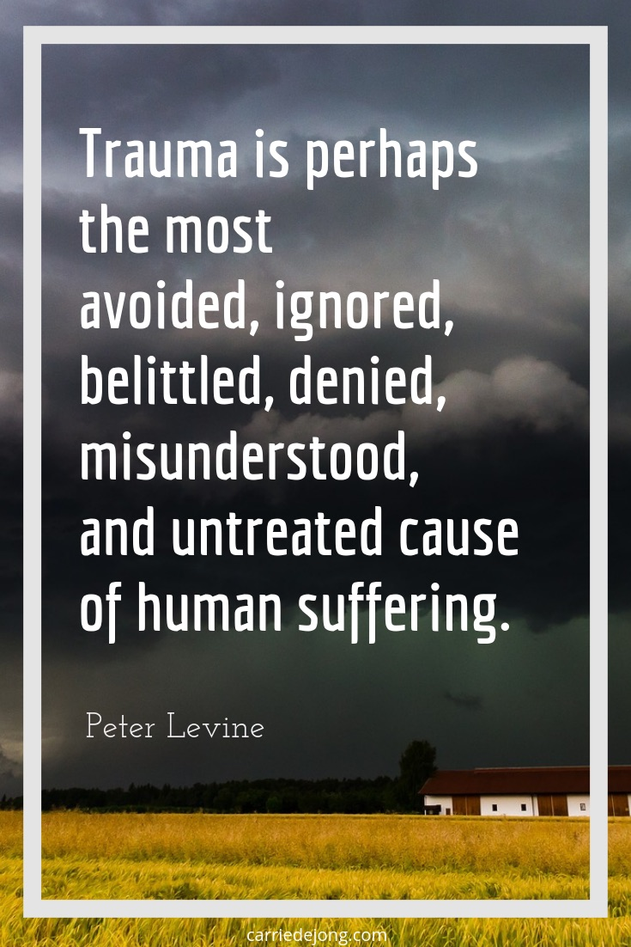
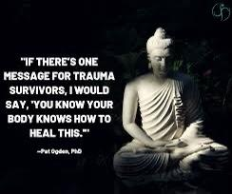
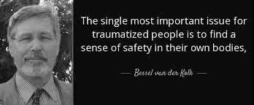
Other Experts Say:
Dr. Peter Levine:
Dr. Bessel Van der Kolk:
Dr. Pat Ogden:
Dr. Nadine Burke Harris:

Slide 8
Secondary Trauma? Burn Out? Compassion Fatigue?
Burn-Out: Overwhelming emotional exhaustion, depersonalization and Feelings of profession insufficiency.
Compassion Fatigue: General emotional and physical exhaustion often experienced by those in the social work profession.
Secondary/Vicarious Trauma: Exposure of those in the social work field through their experiences with clients who have trauma. That trauma can lead to internal and external experiences of trauma symptoms.
Another way to look at trauma: Brain and Trauma
Notes:
-Trauma that most of our clients experiences is the primary factor in our own stress and trauma through our professions. This is especially true as many of us feel drawn to the profession due to our own needs to understand our own life experiences.
-It become very cyclical; we feel drawn to work with those in need without understanding our own needs and that has us working harder to help others in the hopes of understands others and therefore ourselves.
-In the process, we forget to take care of ourselves. How many time do we forget to take a lunch, a day off, a weekend off or even a vacation?
-Let's look at some of the response that can come from trauma:

Slide 9
How Many of Your Organizations/Agencies Have Policies or Practices to Prevent Trauma?
Notes:
Does your supervisor or other person talk to you about secondary trauma?
Does your agency have specific policies or procedures in place to address the trauma exposure you receive from clients?
Do you know where to go (outside the agency) if you are having problems?

Slide 10
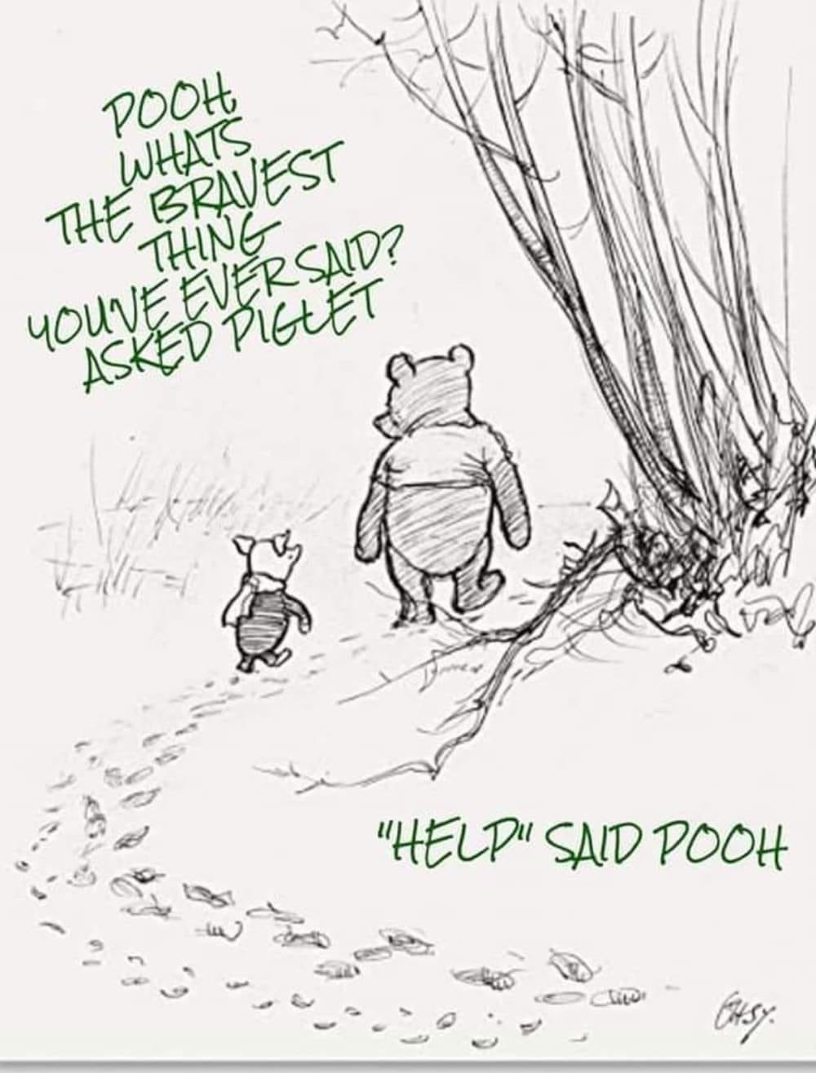

Slide 11
Secondary Trauma can also show up as a trauma response in our bodies:
But we need to ask of our responses:
How is this helping us become our more truest selves?
How does it help us work with our clients?
How can is this sustainable in the long run?
Notes:
-A trauma response happens when a external trauma becomes part of our internal awareness/reality.
-According to Dr. Peter Levine, some parts of a trauma response might serve us in some capacity or be reinforced through our organizations/agencies and the larger communities
A recent study by Brian Bride of the University of Georgia found that exposure to the trauma of others by social workers doubled the risk of PTSD.

Slide 12
Trauma Responses

Slide 13
Trauma Responses:
Feeling Hopeless/Helpless.
A Sense that One Can Never Do Enough.
Hypervigilance.
Diminished Creativity.
Inability to Handle Complexity.
Minimizing.
Chronic Exhaustion/Physical Ailments.
Inability to Listen/Deliberate Avoidance.
9. Dissociative Moments.
10. Sense of Persecution.
11. Guilt.
12. Fear.
13. Anger and Cynicism.
14. Inability to Empathize/Numbing.
15. Addictions.
16. Grandiosity
Notes:
*Hopelessness/Helplessness: Holding ourselves responsible, feelings like there is not end, and the current struggle with repeat itself in the future.
*Never do enough: Connected to systems of oppression; us versus them ideals, inferiority due to unrealistic expectations and a scarcity mentality. We get these messages from large society and within our family.
*Hypervigilance: Being solely focused on our jobs/careers to the exclusion of everything else.
*Diminished Creativity: Decreases our joy as well as innovation at work.
*Complexity: Can come from primary trauma experiences as well as a need for safety. A focus on complexity can be scary to see all the sides of us that we both like and dislike.
*Minimizing: We start to need more and more extreme examples of pain and trauma in order to move us.
*Dissociative moments: This happens when someone experiences intense and overwhelming feelings. These moments can happen more frequently for people with backgrounds similar to their clients or personal situations.
*Guilt: One of the strongest responses as well as a good blocker of positive emotions/experiences. It can also block us from being present and experiencing positive life experiences.
*Fear: It can make us feel vulnerable which at times feels unsafe as well as if we are experiencing a life and death situation.
*Inability to Empathize/Numbing: Often as a result of too much stimuli in our lives as well as the seduction of adrenaline. When we are under constant movement/energy/crisis it is hard to return to a more stable, balanced emotional state. PAGE 107
*Addictions: not only to substances, food, and possibly sex...this also happens with adrenaline.
*Grandiosity: When our work becomes our identity and we become attached to helping/saving/rescuing and being a part of the crisis/drama of another person’s life because it helps us feel needed and useful.

Slide 14
BREAK TIME!

Slide 15
Self Care?
What is self care?
The current buzzword!?!

Slide 16
What is Self Care Really?
It’s not a warm bath or sitting down with a good book.
According to the NASW Policy statement on Self-Care and social work:

Slide 17
NASW Social Policy on Self Care
Area One: Creating and supporting organizational policies/procedures to support self care to staff and those in management. Also modeling self-care within organizations.
Area Two: Development, promotion along with creation of self care plans, ideas, and continuing education training.
Area Three: Training of social workers/supervisors, publications on self-care and research on secondary trauma in social workers.
Source: http://cantasd.org/wp-content/uploads/CWVE18_NASW.ProfessionalSelf-Care.pdf
Notes:
-Created in 2009 by NASW
-Policy Statement on Self-Care
-Has about 11 statements in it.
-The link has information about the policy.

Slide 18
Definitions of Self-Care:
“Personal Self-Care is a process of purposeful engagement in practices that promote well being and holistic health.”
“Professional Self-Care is purposeful Engagement in practices that promote effective use of the self in the professional role within the context of sustaining Holistic health and well-being.”
These definitions fail to see a more holistic approach.

Slide 19
Who spoke with you about Self-Care?
Notes:
Was it supervisor? Mentor? Professor? Older SW? Family member? Partner??

Slide 20
Self Care Should:
Address our social, physical, psychological, financial, spiritual and practical needs.
Should happen during our professional and personal time.
Examples: use of healthy supervision, mindfulness,professional development, setting boundaries, and healthy lifestyles overall.

Slide 21
Self Care should also:
3. Be part of the what people are taught in school.
4. Be taken critically and seriously!!

Slide 22
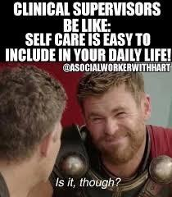

Slide 23
How Can We Build a Self-Care Habit?

Slide 24
Frameworks of Self-Care:
imPAACT:
Stage 1: Prioritize
Stage 2: ACT and Access
Stage 3: Connect Internally & Externally.
Stage 4: Thrive!
Notes:
Prioritize: explore you interferes, set a goal and incorporate your interests into a dailly schedule.
Act and Access; Create a goal and work on figuring out what is working and what is not along with making adjustments along the way.
Connect: Both internally and externally with others not in the field. Also, someone who will hold you accountable to your self-care goals.
Thrive: Fully engaged in your self care plan.

Slide 25
A More Trauma Informed Framework:
Goal:
Presence, mindfulness and felt sense, choice and flexibility.
ACT:
Build Awareness.
Commit to your needs.
Take it slow and steady.
Notes:
To understand anything, building awareness is the first step. This is often a slowing down to be honest in how we are feeling.
Peter Levine described the term as “felt sense“ where you are and how you are feeling moment to moment.

Slide 26
Awareness:
Felt Sense
Slowing Down
Building a Meditation Practice
Notes:
Felt Sense: Concept created by Dr. Peter Levine. It’s the idea of understanding where you are and how you feel moment to moment. According to Dr. Levine, we have built in mechanisms that help respond to and move towards natural resolutions of trauma. It also a bodily awareness of a situation, person or event. An internal awareness or aura that brings together everything you know and feel together.
Slowing Down; take time, notice, being present, observing and seeing.
Meditation practice; can be prayer, breathing, mindful movement (like yoga, qigong and any other purposeful movement practice).

Slide 27
Commit
Explore your interests.
Choose an interest.
Take small steps to add it into your life.
Trying something small!

Slide 28
Take it Slowly
Adding something new to our schedules and lives does not need to be huge!
Progress is often in those small steps and increments.
Adjust and be realistic as needed; it doesn't work? Don’t do it!

Slide 29
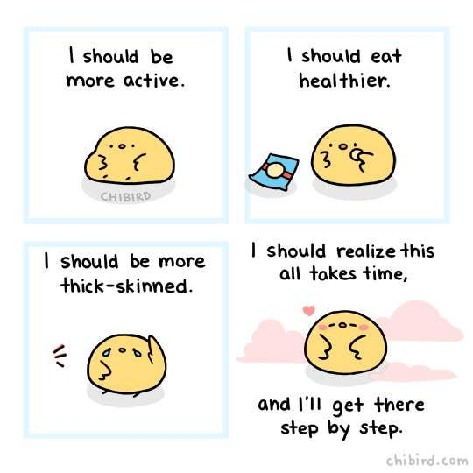

Slide 30
Final Exercise!
Notes:
Mindfulness exercise.

